Slide 1
Rajiv Gandhi University Of Knowledge Technologies Andhra Pradesh
RK Valley Institute
(Constituted under the A.P Govt,Act 18 of 2008 and recognized as per Section 2(f),12(B) of UGC Act,1956)
Accredited by "NAAC" with "B+" Grade
DEPARTMENT OF COMPUTER SCIENCE AND ENGINEERING
ABHIYANTH PRE-ORDER BOOKINGS
Under the Guidance of
A.MAHENDRA
M.HINDU PRIYA
R190581

Slide 2
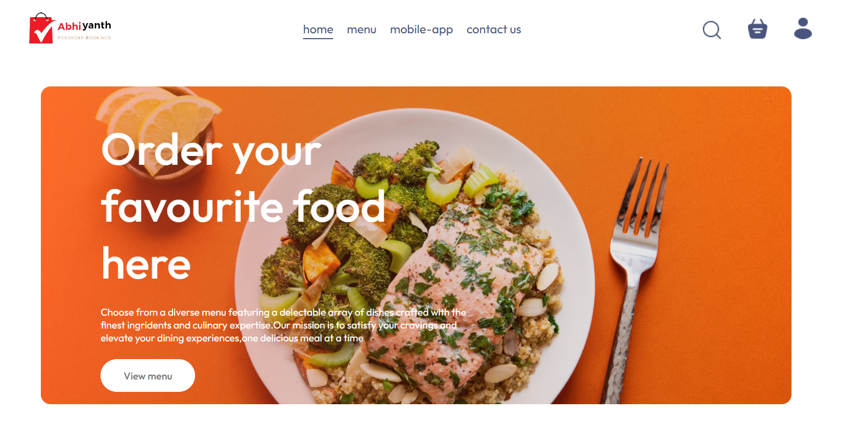
Abstract
The frontend implementation of the Abhiyanth Preorder Bookings platform ensures a user-friendly and efficient ordering experience. Designed to cater to the needs of students, vendors, and administrators, the platform includes essential features such as login and registration, which simplifies user access and management. Menu browsing allows users to easily navigate and select items, while cart management facilitates the addition and removal of items before purchase. Additionally, the platform's responsive design ensures compatibility across various devices, providing a seamless experience whether accessed from a desktop, tablet, or smartphone. The intuitive user interface is designed to minimize the learning curve, allowing users to quickly become proficient in navigating and utilizing the platform.
.

Slide 3
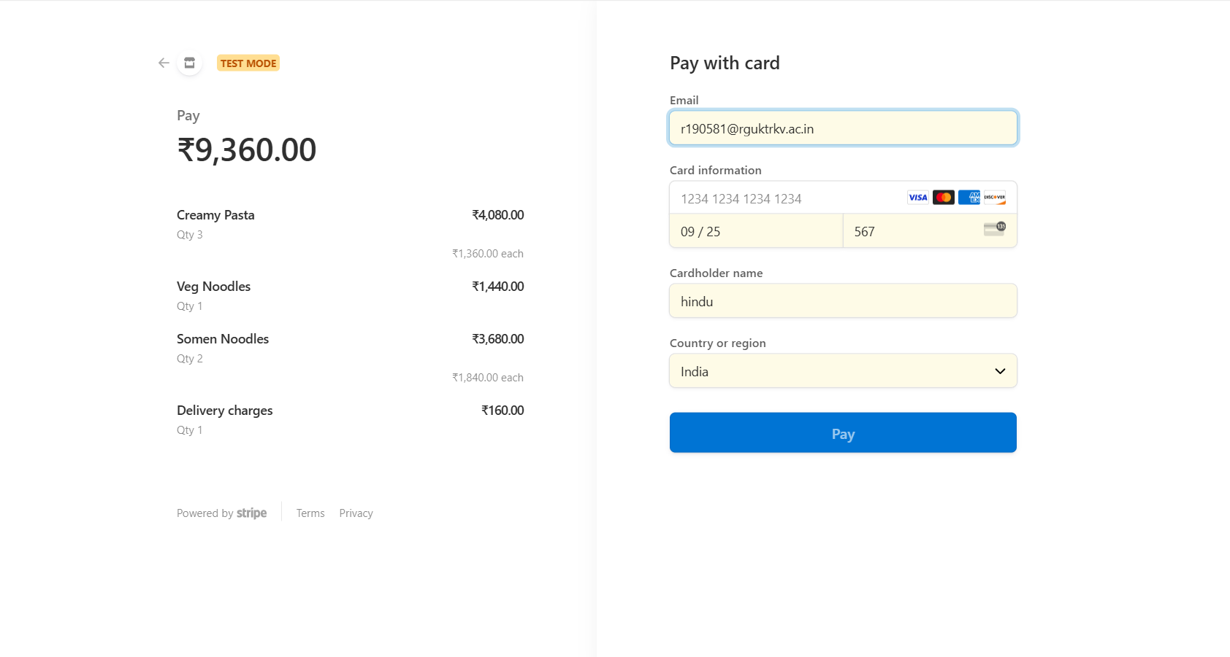
The platform also integrates advanced features like secure payment processing to ensure safe transactions for users and order history tracking, which helps users keep track of their previous orders. Notifications and alerts keep users informed about order status and updates, enhancing communication and reducing uncertainties. The comprehensive approach not only simplifies the preordering process but also enhances the overall user experience, making the Abhiyanth Preorder Bookings platform a valuable tool in the academic environment. Furthermore, analytics and reporting tools are provided for administrators to monitor and optimize the system's performance, ensuring continuous improvement and adaptation to user needs. The platform also supports multiple payment options, including credit/debit cards and digital wallets, to cater to diverse user preferences.

Slide 4
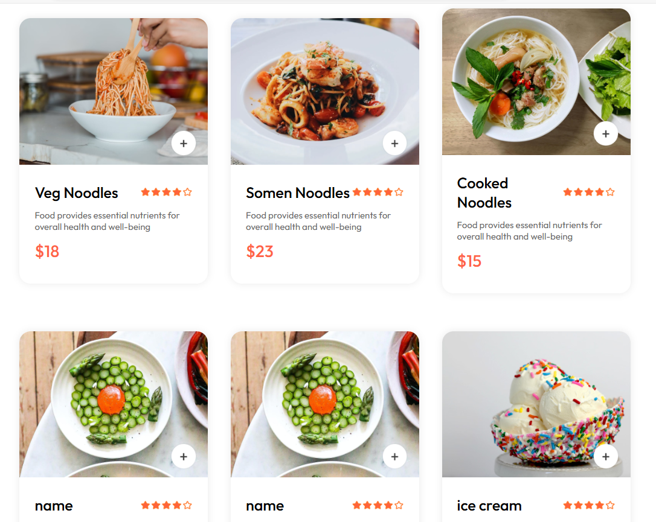
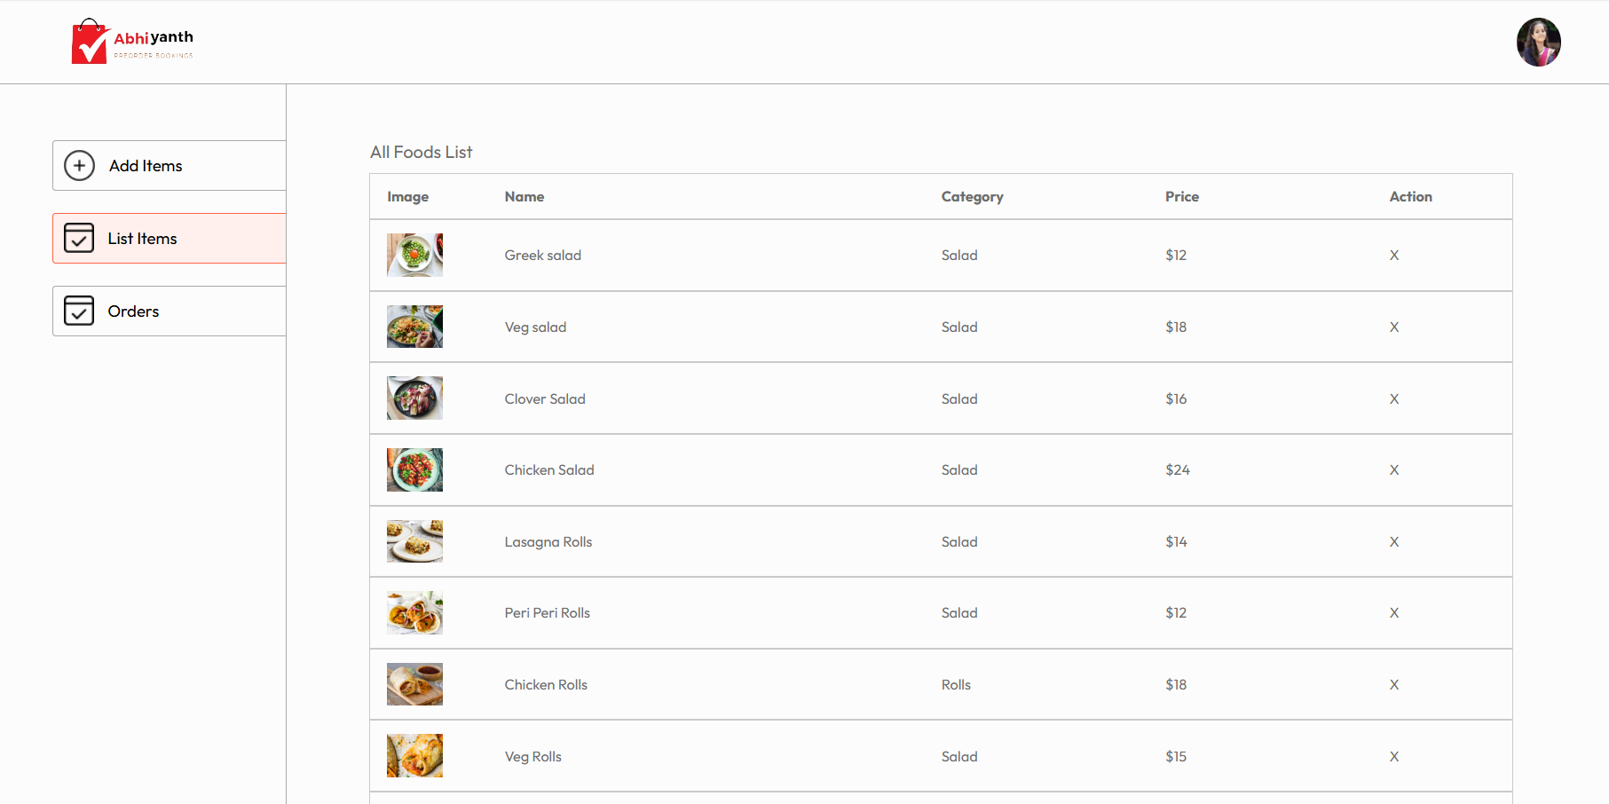
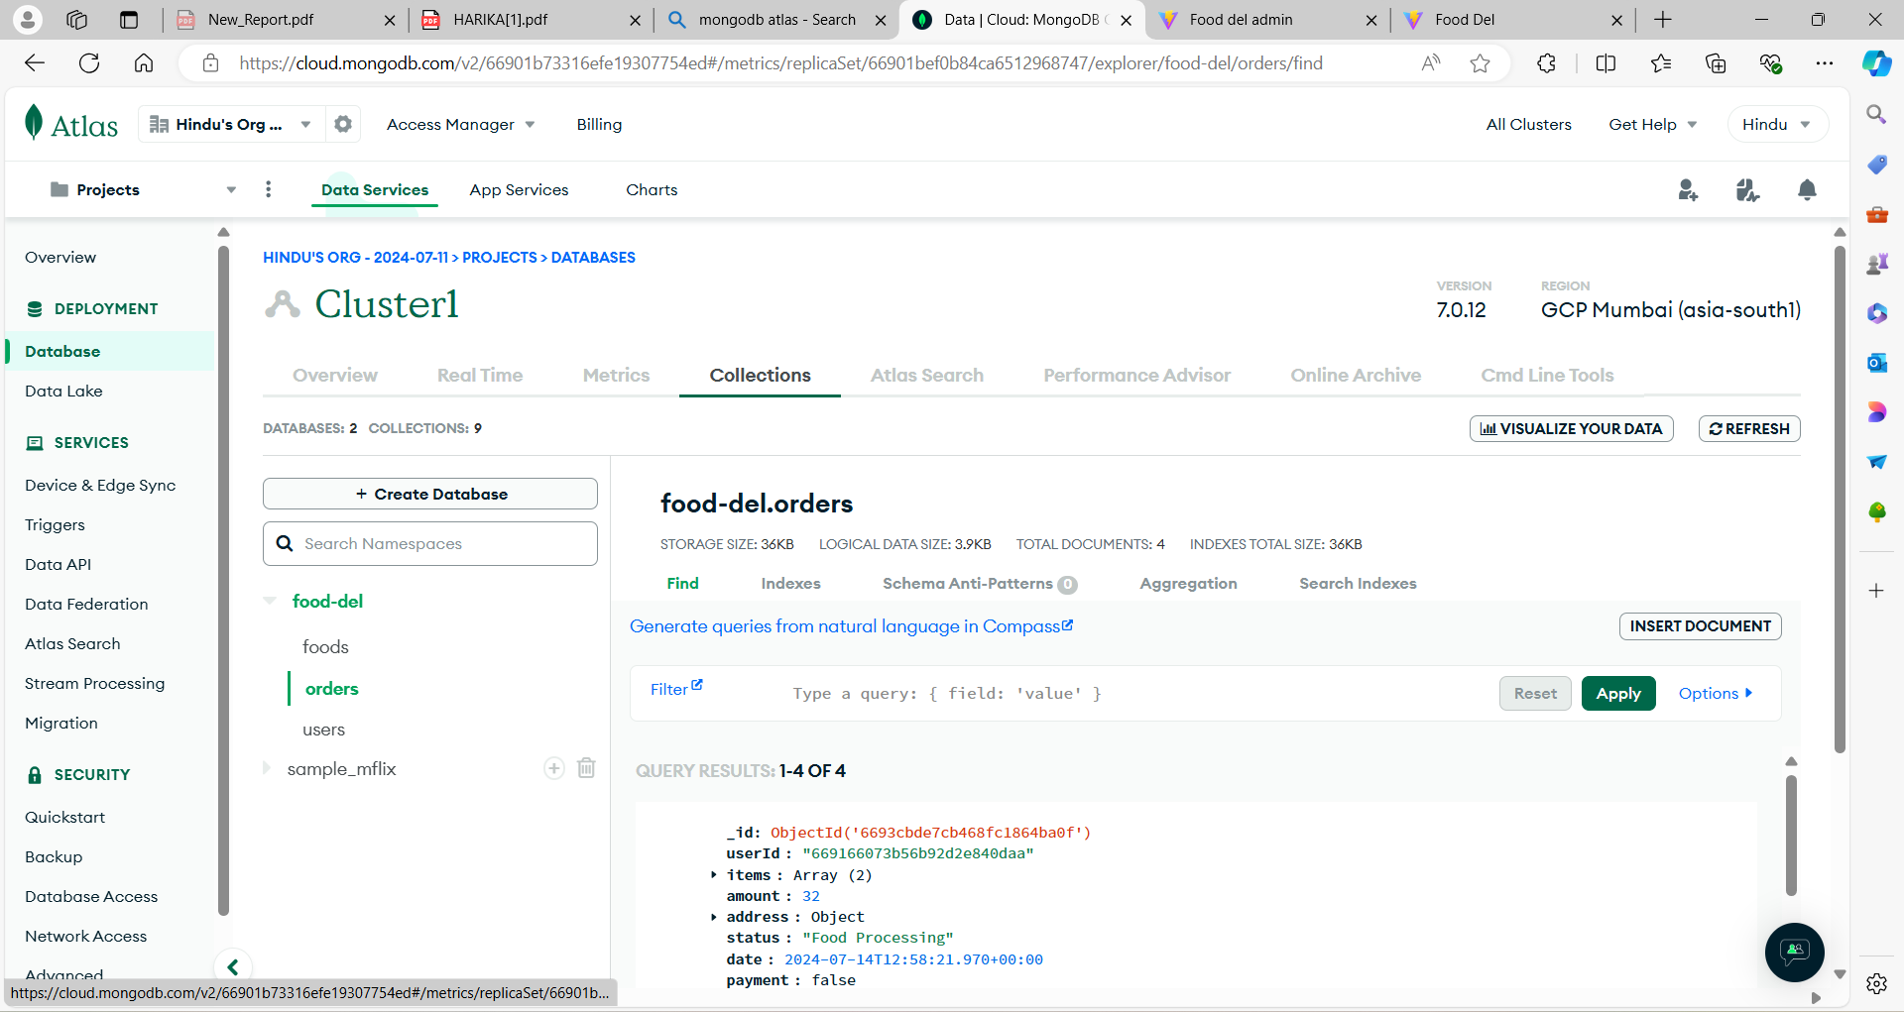
Introduction to ABHIYANTH PRE-ORDER BOOKINGS
The Abhiyanth Preorder Booking platform streamlines the preordering process for students with convenient features like menu browsing, secure payments, and order tracking. Designed to enhance efficiency and user experience, it caters to students, vendors, and administrators in an academic setting.

Slide 5
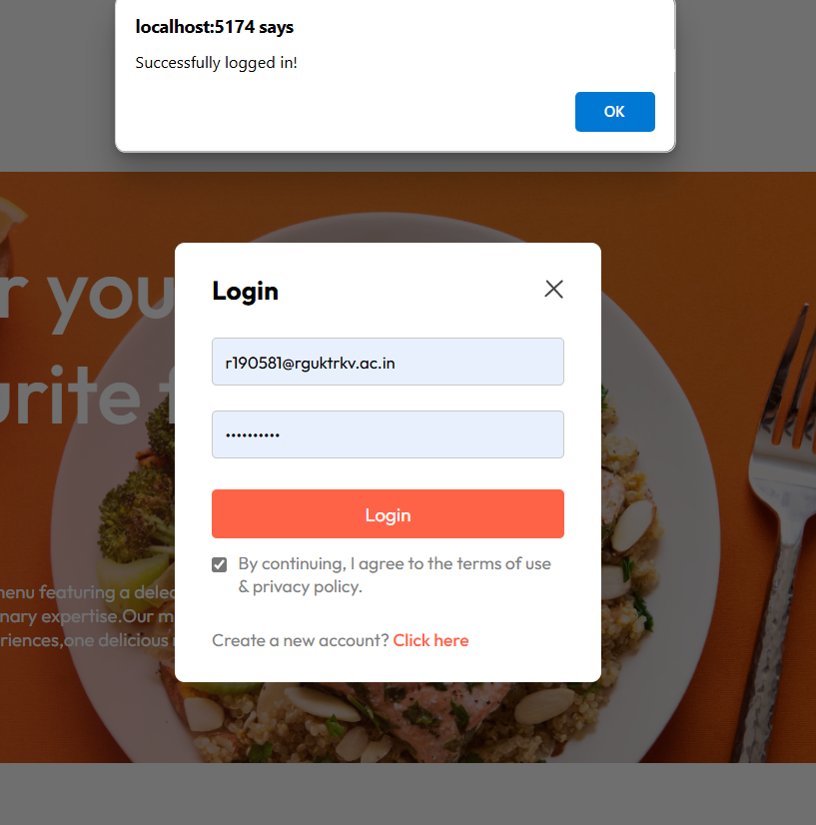
LITERATURE
Preorder systems in academic environments offer significant benefits, including time savings, reduced workload for students, and streamlined vendor operations. Research and industry reports highlight the successful implementation of such systems, demonstrating improved efficiency and user satisfaction. The growing trend of online ordering systems, particularly for food and merchandise, underscores their positive impact on user behavior and business operations.
Design principles emphasize the importance of a user-friendly and accessible interface, increasing engagement and satisfaction. Literature supports secure payment processing and efficient data management, highlighting the need for robust security measures and performance optimization. These insights have shaped the development of Abhiyanth Pre Order Bookings, ensuring it meets user needs and adheres to best practices in technology and design.

Slide 6
Technology Framework
The Abhiyanth Pre Order Bookings platform is built using the MERN stack, comprising MongoDB, Express.js, React.js, and Node.js. MongoDB serves as the database, providing flexibility and efficiency in handling large volumes of data, making it ideal for scalable applications. Express.js functions as the backend framework, offering robust APIs and efficient server-side logic, which enhances performance and streamlines development processes. React.js powers the frontend with a dynamic and responsive user interface, using a component-based architecture and virtual DOM to ensure fast and interactive user experiences. Node.js enables server-side JavaScript execution, known for its scalability and performance benefits, creating a seamless development environment.
Data flows seamlessly between the frontend, backend, and database through RESTful APIs, ensuring smooth interactions and efficient data management. Integration with third-party services like Stripe ensures secure payment processing, enhancing the platform’s reliability and user trust. Comprehensive security measures, including encryption, authentication, and authorization, protect user data and transactions, adhering to industry best practices. Performance optimization techniques such as caching and load balancing are employed to maintain the platform’s efficiency and responsiveness, ensuring a smooth and reliable user experience.

Slide 7
Benefits of my Abhiyanth Pre-order Bookings
Convenience for Students:
Efficiency for Vendors:
Improved Administration Oversight:
Students save time and avoid queues by pre-ordering items, ensuring a seamless and efficient ordering process that fits their busy schedules and enhances their overall campus experience.
Vendors benefit from streamlined operations, enhanced inventory management, and reduced overhead costs, leading to improved profitability and customer satisfaction.
Administrators gain better insights into student preferences and order patterns, facilitating informed decision-making, resource allocation, and overall campus management strategies.

Slide 8
Motivation of my Abhiyanth pre-order Bookings
Enhanced Convenience and Efficiency
The Abhiyanth Preorder Bookings platform streamlines the ordering process for students managing stalls, saving time and effort. It digitizes preorder tasks, allowing students to focus on other activities. This efficiency benefits both stall managers and their peers.
Improved Order Management
Our platform reduces errors and miscommunications in order management. With features like menu browsing and order history tracking, it ensures accurate and reliable order processing. This enhances user experience and customer satisfaction.

Slide 9
Empowering Student Entrepreneurs
The platform provides a professional tool for student entrepreneurs to manage their stalls efficiently. Its intuitive interface and features help develop essential business skills. This support fosters entrepreneurship and personal growth.
Fostering a Connected Community
The platform promotes a sense of community by facilitating seamless interactions between students and stall managers. It encourages support for peers' ventures, creating a vibrant and engaged atmosphere. This connectedness strengthens the academic community.
Adapting to Modern Technology Trends
Leveraging modern technologies like the MERN stack, the platform ensures a responsive user experience. It meets current student demands while preparing the institution for future advancements. This adaptation maintains relevance in the digital landscape.

Slide 10
My Contributions to the Abhiyanth Pre-Order Bookings Application
Technical Contributions
Developed the idea to streamline the preorder process for student-run stalls, focusing on efficiency and convenience. Implemented user-friendly interfaces using React, ensuring seamless navigation and interaction. Integrated MongoDB, Express.js, and Node.js to create a robust backend for secure data management and processing. Integrated Stripe for secure and efficient payment processing, enhancing the overall user experience.

Slide 11
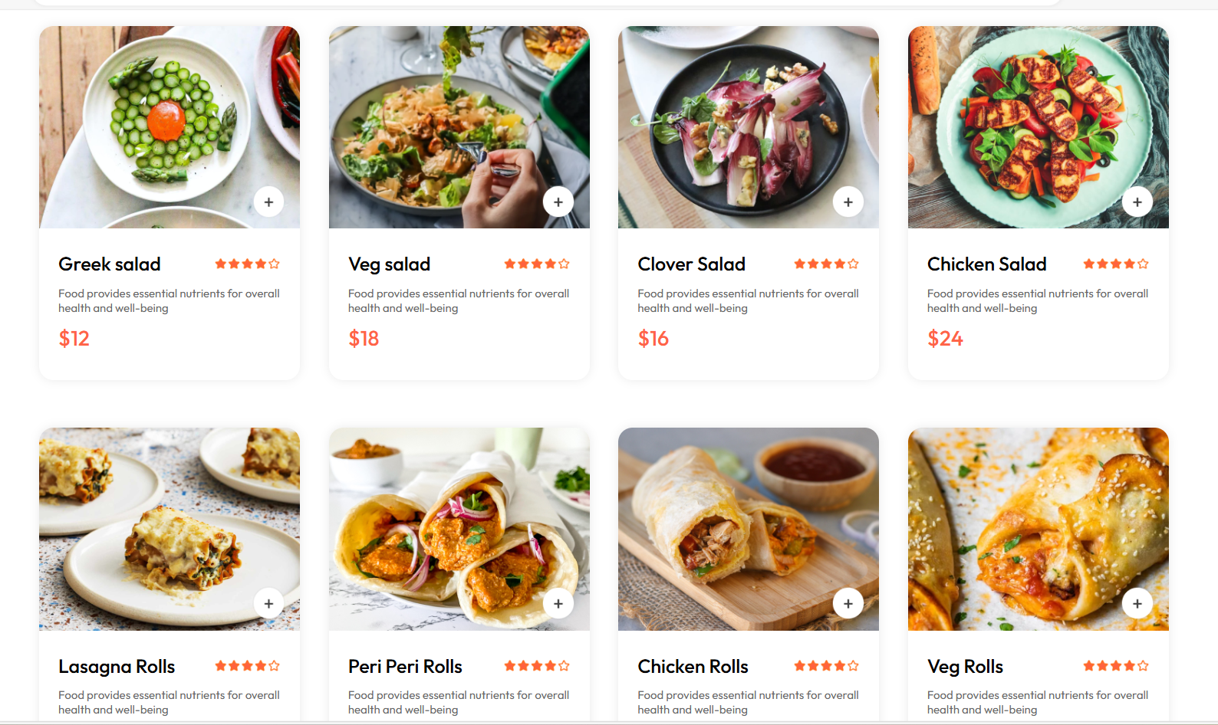
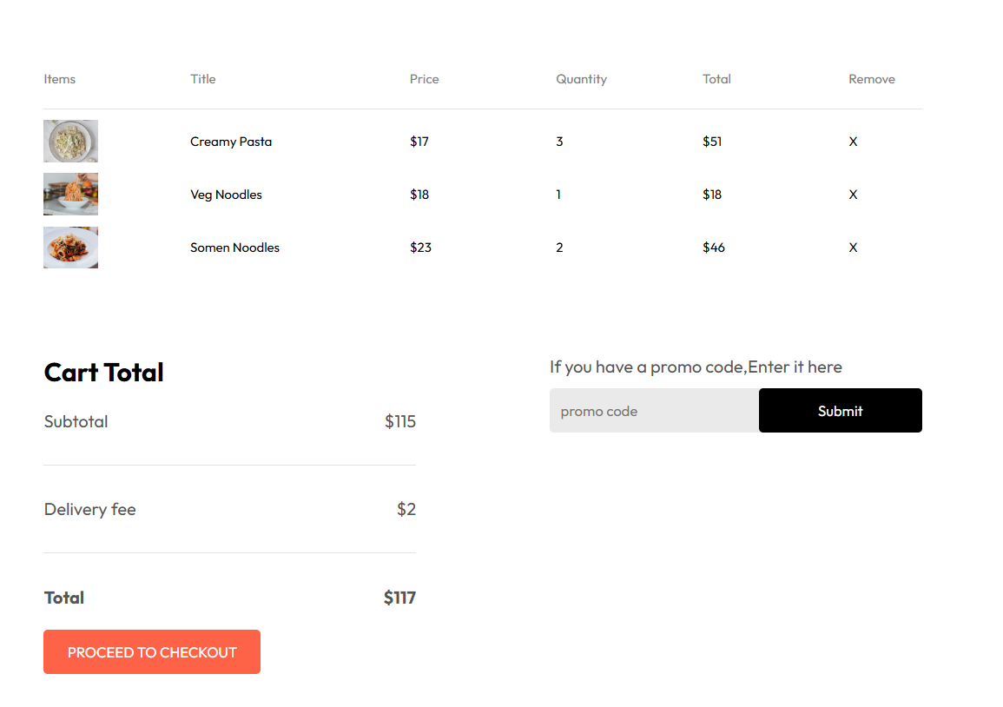
Modules in a Abhiyanth Pre-Order Bookings
Module1
The first module focuses on developing a user-friendly interface for the Abhiyanth Preorder Bookings platform. This involves creating intuitive navigation and seamless interaction using React. The aim is to ensure that users can easily browse menus, manage their carts, and place orders without any hassle. By prioritizing user experience, this module sets the foundation for a successful and engaging platform.

Slide 12
Module2
The second module addresses the backend infrastructure and data management of the platform. By integrating MongoDB, Express.js, and Node.js, we create a robust and secure system for handling user data and orders. This module focuses on ensuring that all data is stored and processed efficiently, maintaining the integrity and reliability of the platform.

Slide 13
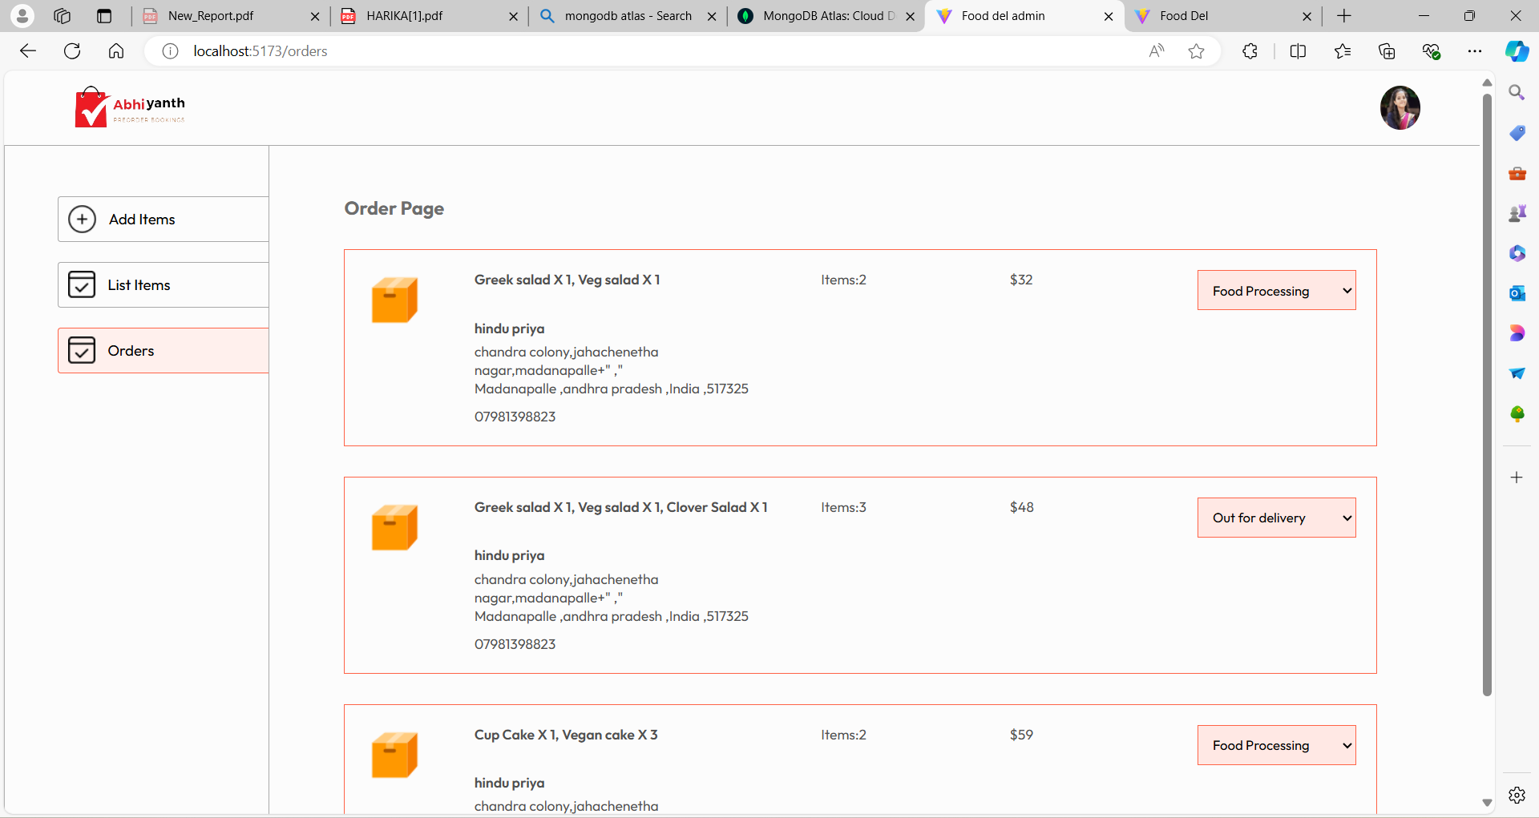
Module3
The third module concentrates on the order management system and fostering a connected community. An organized system for recording and tracking orders is designed to minimize errors and streamline the entire process. This module ensures that users can view their order history and receive accurate updates on their orders, enhancing their overall experience.

Slide 14
Community and System Enhancements
Designed and developed an organized system for accurate order recording and tracking, minimizing errors. Fostered a connected and supportive academic community through a platform that encourages peer engagement and entrepreneurship.

Slide 15
Conclusion and Future Enhancements
The Abhiyanth Preorder Bookings platform has successfully streamlined the preorder process for student-run stalls, enhancing convenience and efficiency for both stall managers and their peers. With a user-friendly interface, robust backend, and efficient order management system, the platform ensures a seamless and satisfying user experience. Looking ahead, we envision integrating AI to offer personalized recommendations and expanding payment options to include digital wallets, enhancing convenience. Implementing advanced analytics will empower administrators with insightful data for strategic decision-making, further optimizing operations.
In addition to these technological advancements, future enhancements could include introducing features like horror room registration, enabling users to book unique and thrilling experiences. Collaborating with local businesses and extending the platform’s scope beyond academic settings could broaden its appeal and utility. By embracing innovation and responding to user feedback, the Abhiyanth Preorder Bookings platform will continue to evolve, remaining a valuable tool that enriches the user experience and fosters community engagement.

Slide 16
References
React Documentation. Retrieved from https://reactjs.org/docs/getting-started.html
MongoDB Documentation. Retrieved from https://docs.mongodb.com/
Express.js Documentation. Retrieved from https://expressjs.com/
Node.js Documentation. Retrieved from https://nodejs.org/en/docs/
Stripe Documentation. Retrieved from https://stripe.com/docs

